Slide 1
Designing and Simulating a Directionally Stable Sailboat
Jesse Miller, M.Eng, MAE
Cornell University, 2016

Slide 2
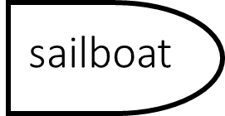
Directional Stability-Basic Idea
Remain on-course without constantly steering (no onboard power)
Unstable
Stable
Desired course
Desired course
Actual Trajectory
Actual Trajectory

Slide 3
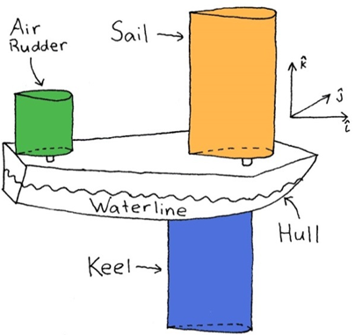
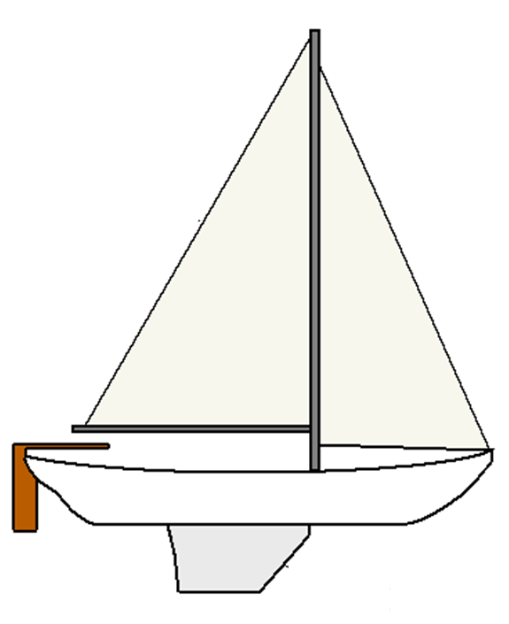
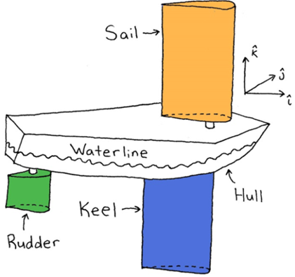
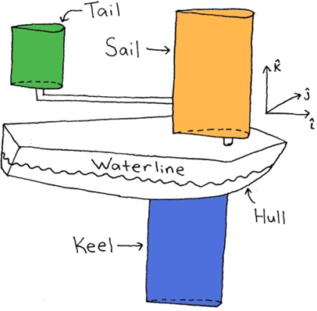
Designs to be Tested
Air Rudder
Water Rudder
Tail
=

Slide 4
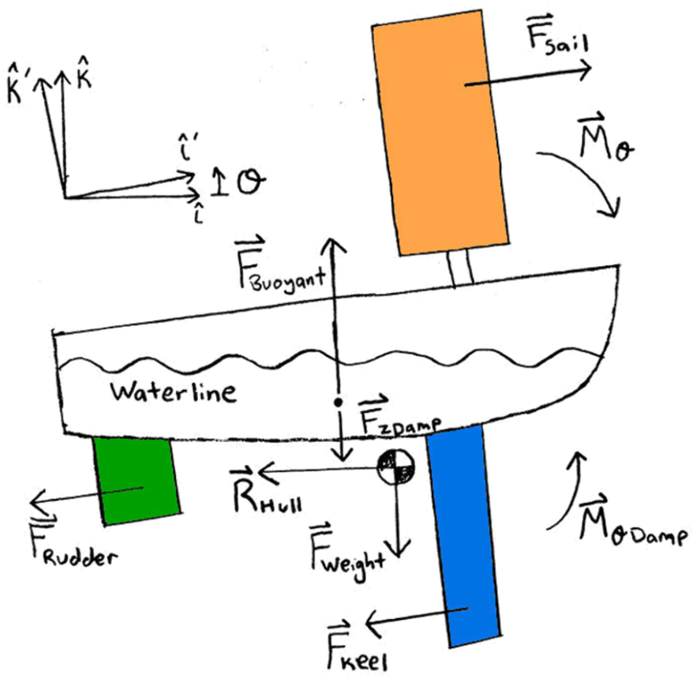
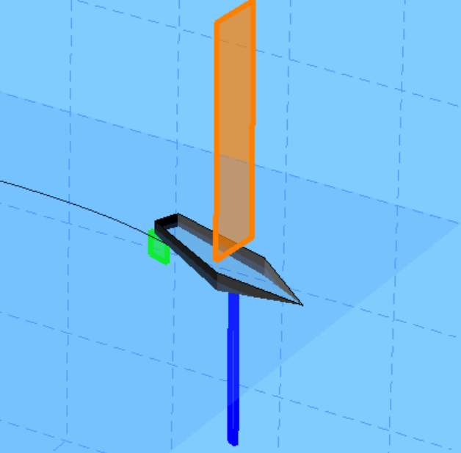
Procedure
Model Forces
Simulate in MATLAB

Slide 5
Sailboat Dynamics Model

Slide 6
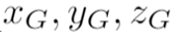
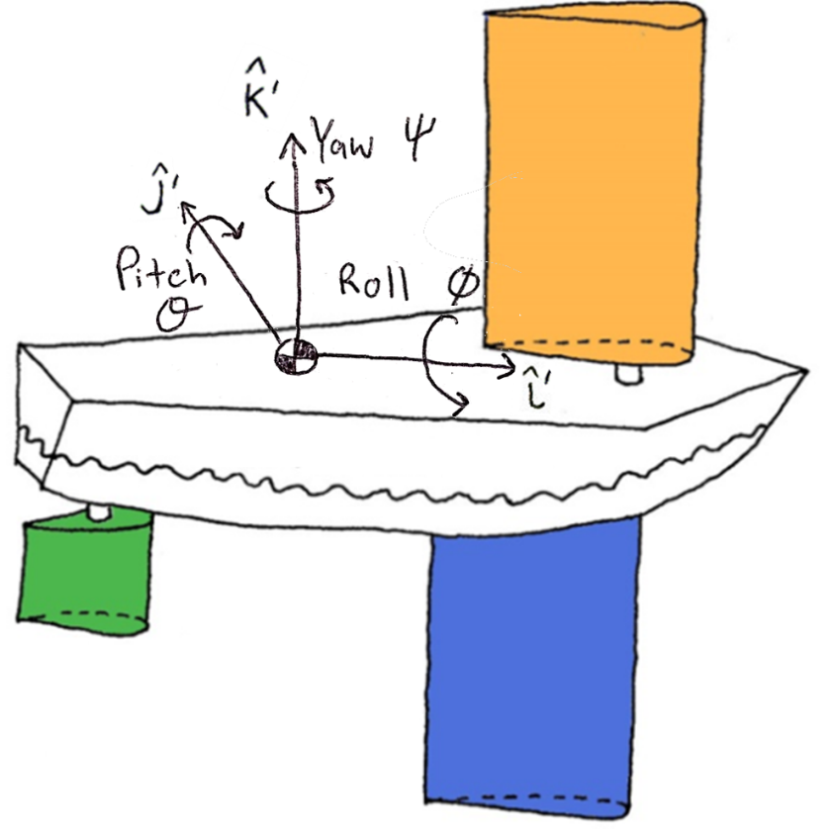
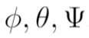
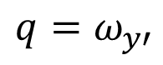
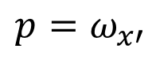
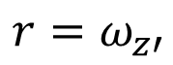
Dynamic Model
State representation
COM coordinates
Euler angles
Rotation rates in body frame
$$p=ω_{x′}$$
$$q=ω_{y′}$$
$$r=ω_{z′}$$

Slide 7
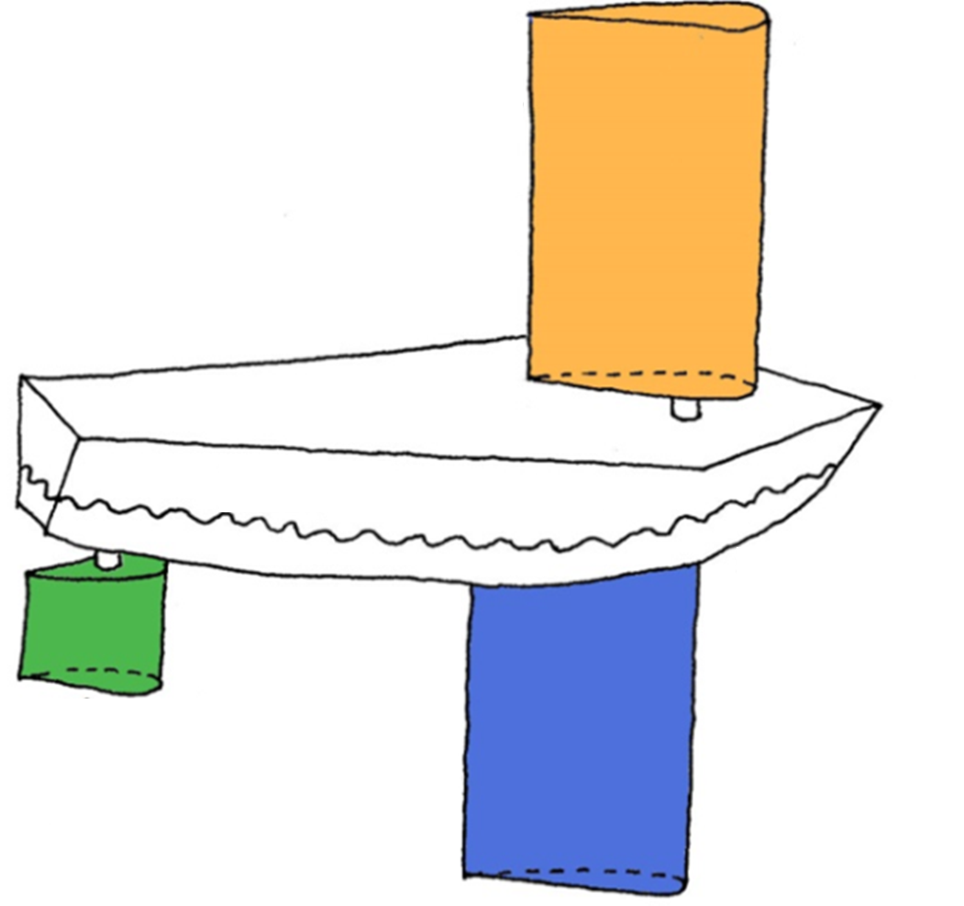

Dynamic Model
Sail, Keel, Rudder are airfoils
airfoil
=
airfoil
airfoil

Slide 8
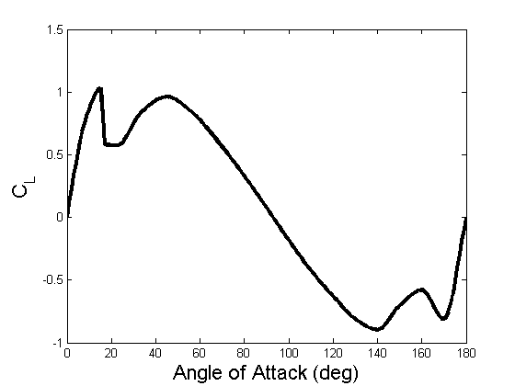
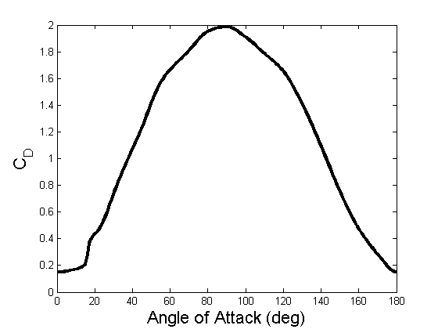
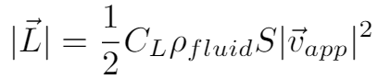
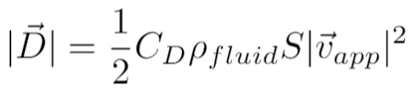
Dynamic Model
Forces on Sail, Keel, and Rudder
Approximate as NACA 0015 airfoil
$$\overset{⃑}{L}$$
$$\overset{⃑}{D}$$
$$α$$
Relative Wind

Slide 9
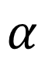
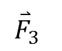
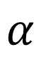
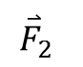
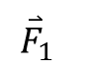
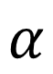
Dynamic Model
Blade Element Theory
Rotational velocity of boat causes non-uniform flow over airfoils
Example with 3 elements:
$${\overset{⃑}{F}}_{3}$$
$${\overset{⃑}{F}}_{2}$$
3
$$α$$
$${\overset{⃑}{F}}_{1}$$
2
$$α$$
Relative Wind
1
$$α$$

Slide 10
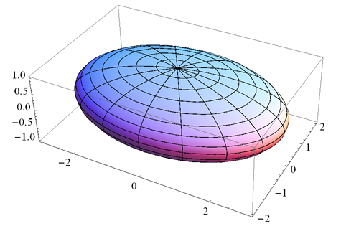
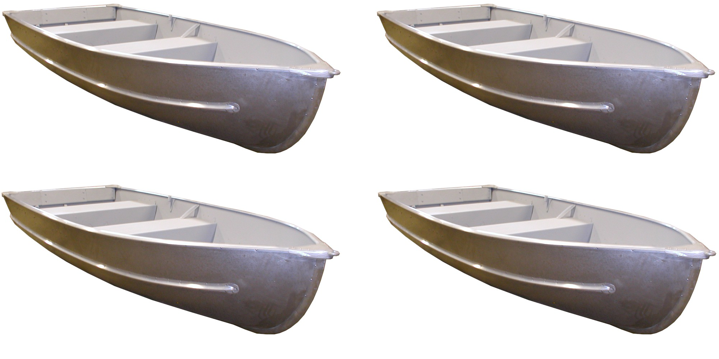
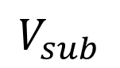
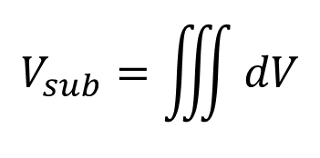
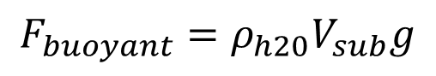
Dynamic Model
Hull Buoyancy
Assume ellipsoid
=
Hull (ellipsoid)
Submerged Volume
$$V_{sub}=\iiint{dV}$$
$$V_{sub}$$
$$F_{buoyant}=ρ_{h20}V_{sub}g$$

Slide 11
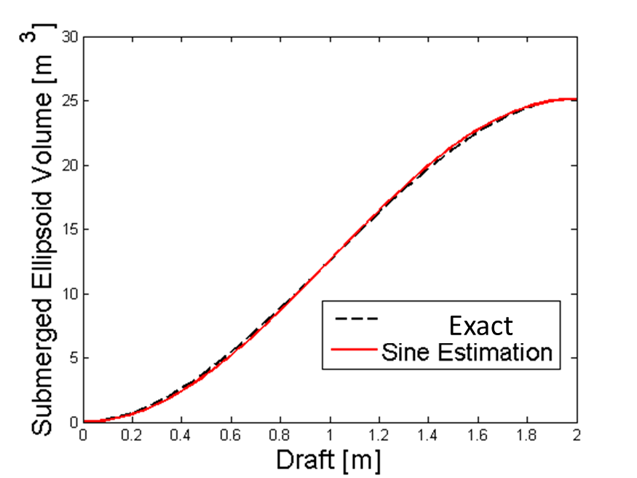
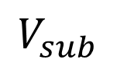
Dynamic Model
Hull Buoyancy
Approximate submerged volume with sinusoid
$$V_{sub}$$
Draft

Slide 12
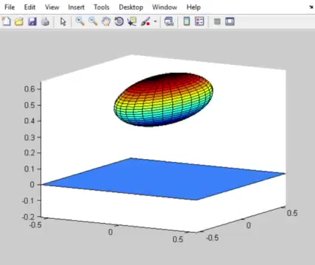
Dynamic Model
Buoyancy Simulation

Slide 13
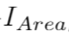
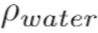
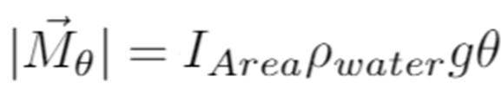
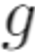

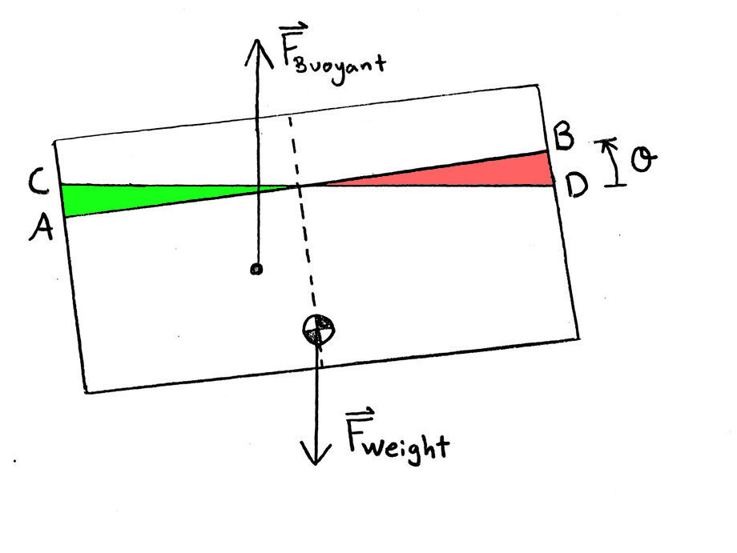
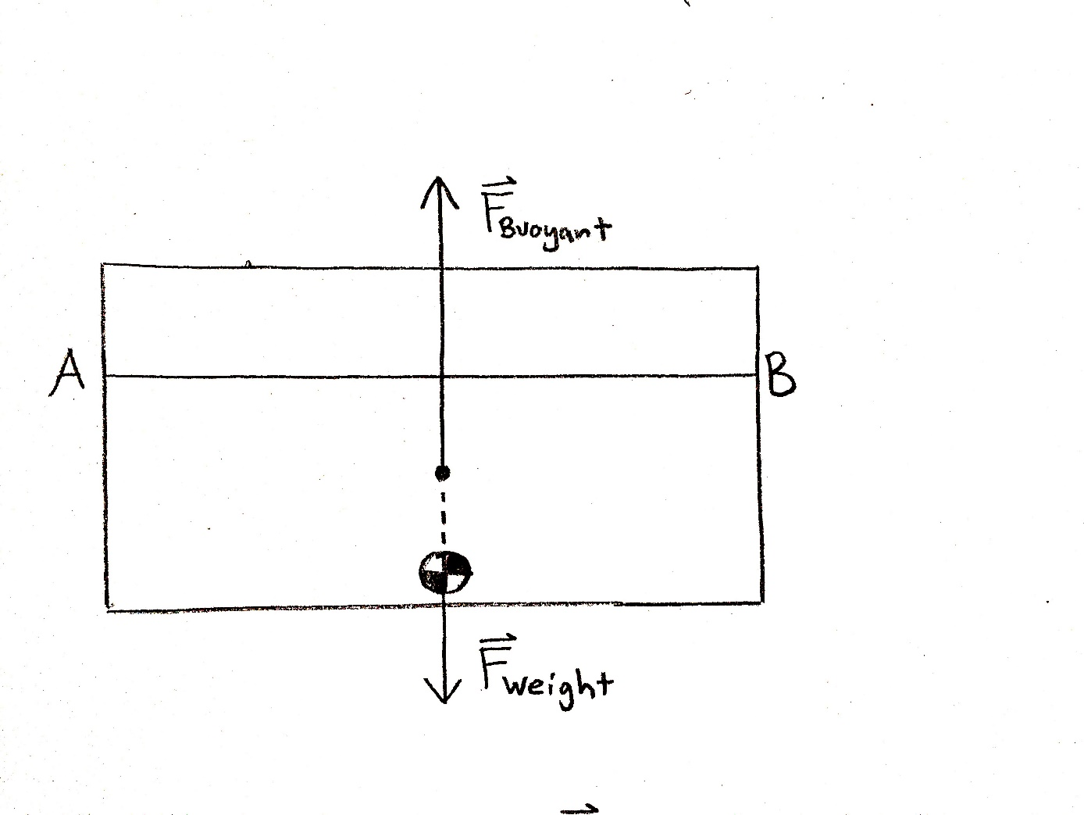
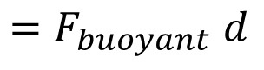
Dynamic Model
Second moment of area of waterplane:
Pitching Moment
Water density:
$${=F}_{buoyant}d$$
Acceleration due to gravity:
Pitch angle:
Side View of Hull:
Lost buoyancy
Gained buoyancy
d

Slide 14
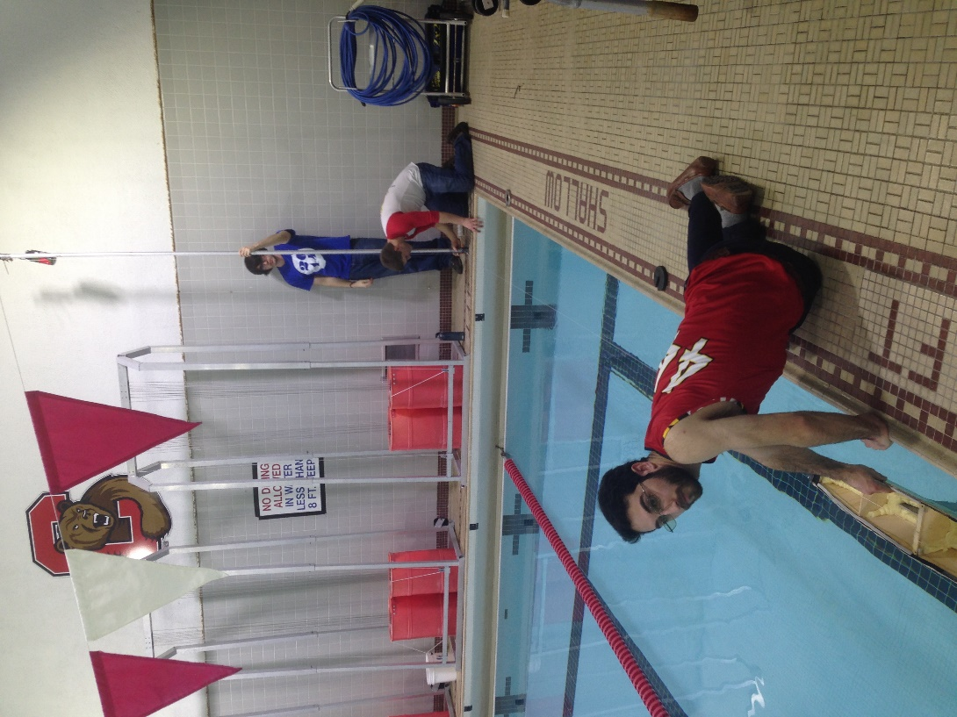
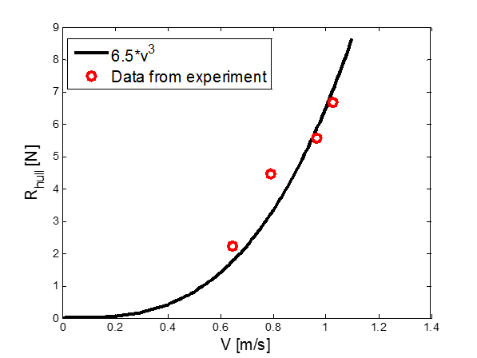
Dynamic Model
Hull Resistance (Drag)
$f\left(hull shape, weight, velocity\right)$
Wave-making resistance
Analyzed experimentally
Weight
Pulley
Boat Hull

Slide 15
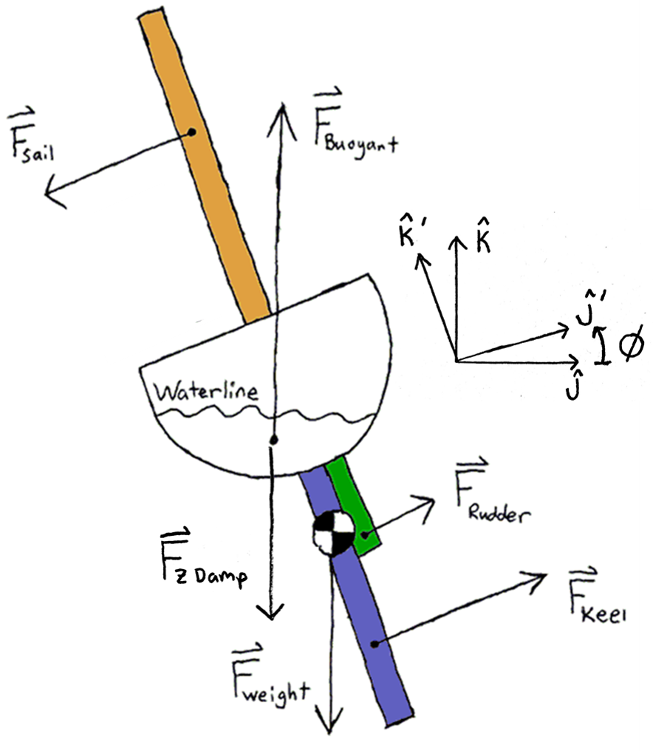
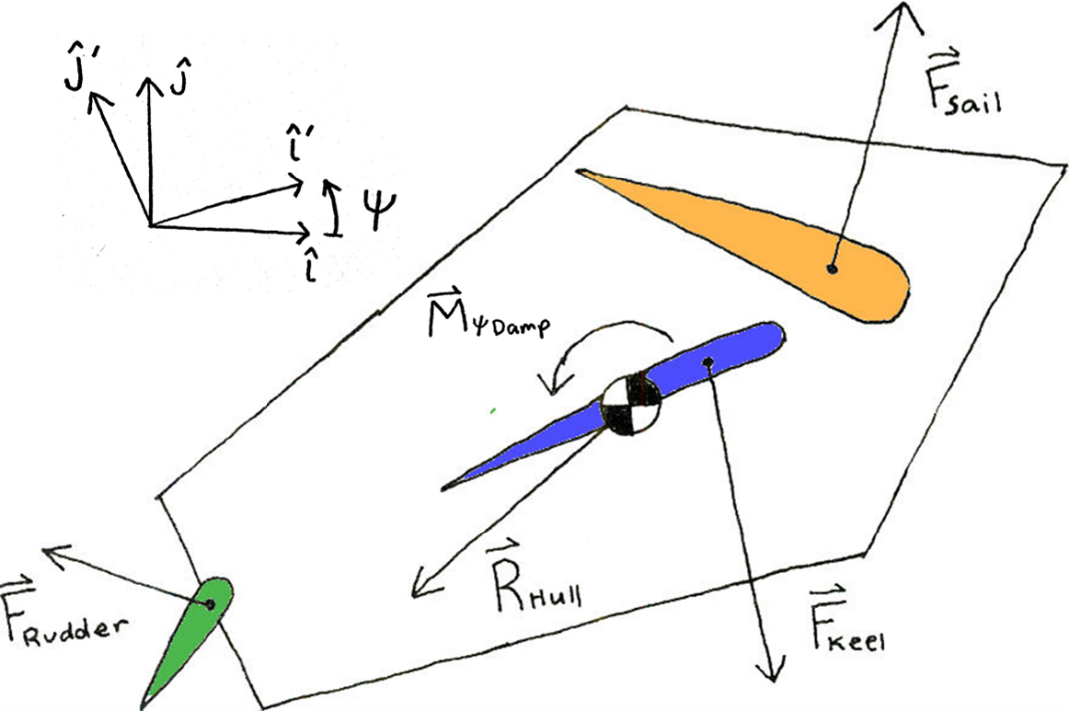

Free Body Diagrams

Slide 16
Sailboat Simulation

Slide 17
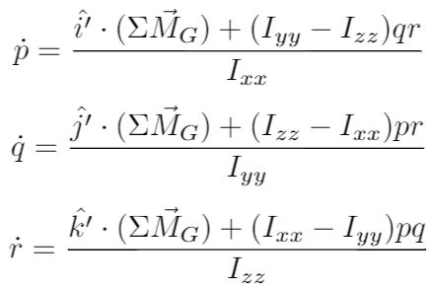
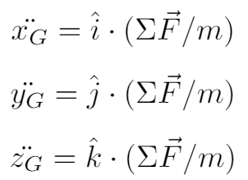
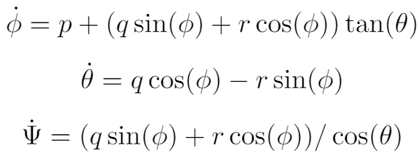
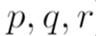
Sailboat Simulation
Linear Momentum Balance
Angular Momentum Balance
Kinematics
COM coordinates
Rotation rates in body frame
Euler angles
Numerically solve in MATLAB with ode45

Slide 18
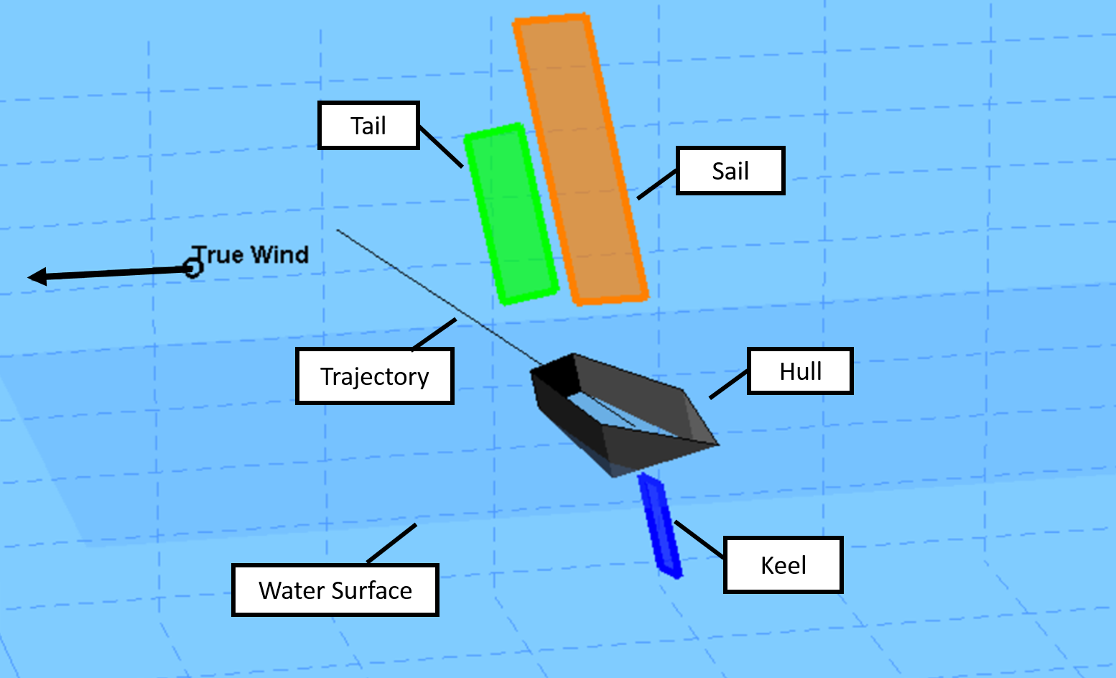
Sailboat Simulation
Animation

Slide 19
Stability Test and Results

Slide 20
Test Stability in Simulation
Water Rudder
Air Rudder
Tail

Slide 21
Inherent Directional Stability
Inherent Directional Stability:
Return to desired heading regardless of initial heading
Resist small disturbances (wind gust)
Sail with stability both upwind and downwind
Do all this without constant energy expense or mechanical response

Slide 22


Test Stability in Simulation
Water Rudder
Inefficient (very slow) stable sailing directions

Slide 23
Test Stability in Simulation
Air Rudder
Limited range of stable directions:
Small disturbance causes stable rudder force
True Wind
disturbance
disturbance
Small disturbance causes unstable rudder force

Slide 24
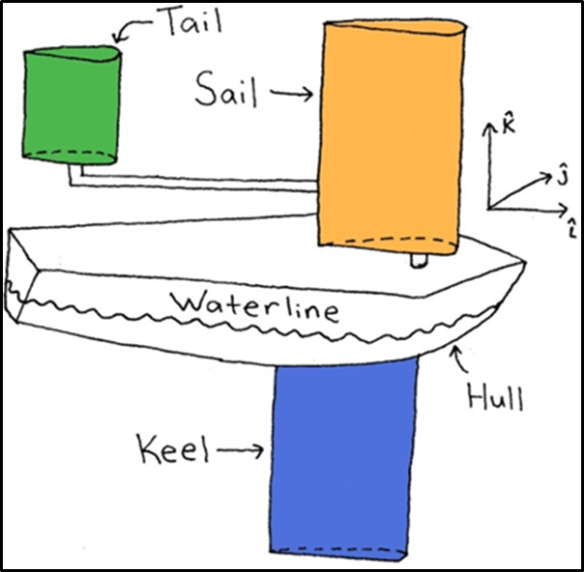
Test Stability in Simulation
Tail
Boat stability in right direction
True Wind
Moment turns boat

Slide 25

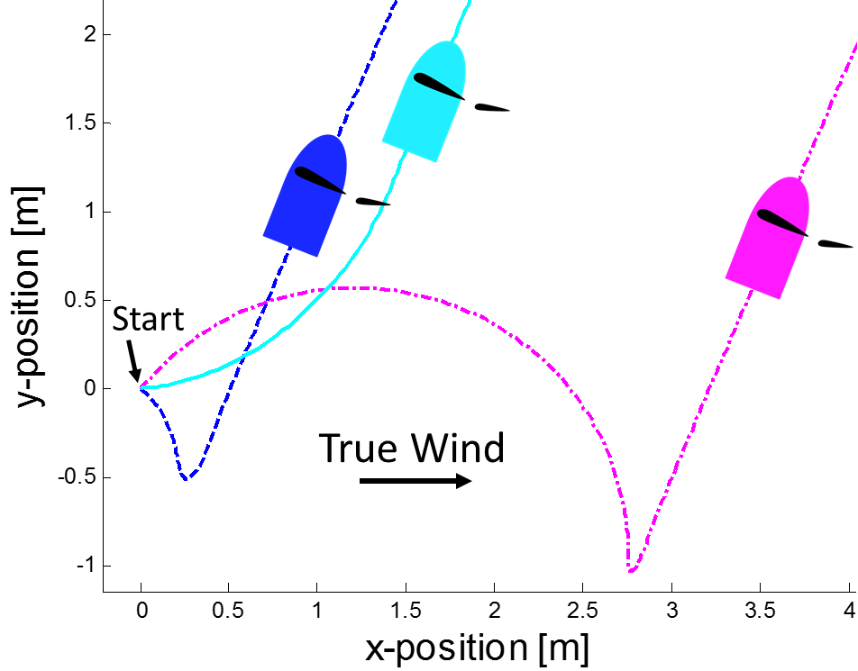
Test Stability in Simulation
Tail
It’s Stable!
Independent of initial orientation in 3D simulation (for small lean)

Slide 26

Test Stability in Simulation
Tail
2 stable equilibrium solutions in 3D simulation when lean angle becomes large.

Slide 27

Test Stability in Simulation
Explanation for multiple stable sailing directions in 3D simulation

Slide 28


Test Stability in Simulation
Explanation for multiple stable sailing directions in 3D simulation

Slide 29

Conclusions
We’ve created a MATLAB sailboat simulation to verify direction stability
We’ve designed a directionally stable sailboat (using a tail design)
Certain conditions create multiple stable directions. We will look into fixing this.
Cornell Autonomous Sailboat Team built the tail design this semester.
Testing at Cayuga lake this weekend!

Slide 30

References
[1]
True Wind Speed |  | $$5 m/s$$ | Ballast Mass |  | $$1.1 kg$$
Sail | Chord Length | $$0.24 m$$ | Water rudder | Chord Length | $$0.1 m$$
 | Span | $$1 m$$ |  | Span | 0.$1 m$
 | Mass | $$0.66 kg$$ |  | Mass | $$0.4 kg$$
 | Distance in front of C.O.M. | $$0 m$$ |  | Distance in front of C.O.M. | $$−0.4 m$$
Keel | Chord Length | $$0.04 m$$ | Air rudder/ Tail | Chord Length | $$0.18 m$$
 | Span | $$0.68 m$$ |  | Span | $$0.46 m$$
 | Mass | $$0.3 kg$$ |  | Mass | $$0.04 kg$$
 | Distance in front of C.O.M. | $$0 m$$ |  | Distance in front of C.O.M. | $$−0.4 m$$

Slide 31
Questions?

